Slide 1
Newton’s 1st Law (Inertia)
Physical Science - Physics

Slide 2
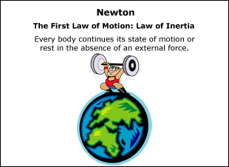
NewtonOVERVIEW
Aristotle: Natural v. Violent Motion.
Galileo: Force and Friction.
NEWTON: Laws of Motion.
Law of INERTIA.
Law of ACCELERATION.
Law of REACTION.

Slide 3
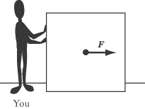
INERTIA
Inertia translate literally as “LAZY”.
An object at rest stays at rest, or an object in motion stays in motion until A FORCE is used.
At Rest
In Motion

Slide 4
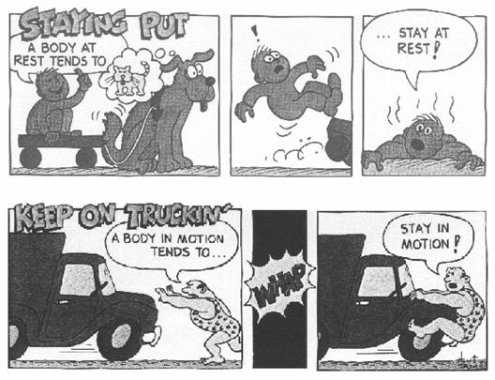
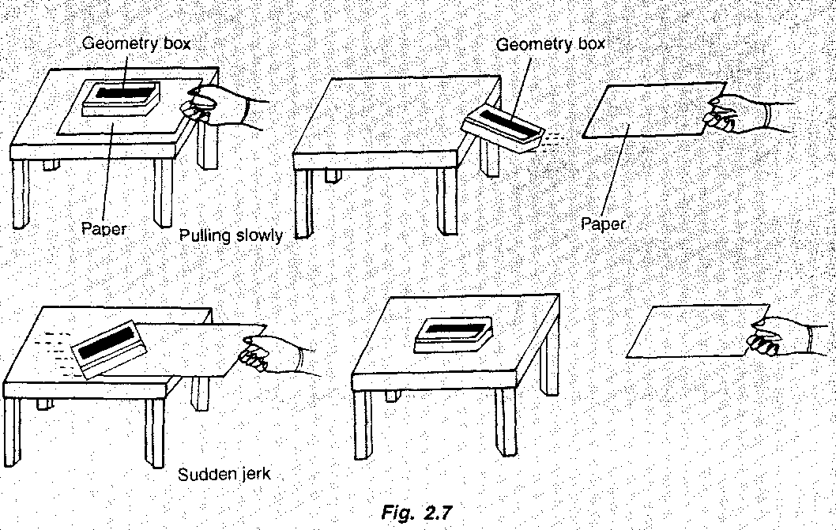
INERTIA

Slide 5
INERTIA Applied 1

Slide 6
The Law of INERTIA
Objects at rest are said to have inertia…
Having inertia means you have mass…
Having mass means you have weight…
Having weight means you exert a force.
Note: 10-N = 1 kg = 2.2 lbs

Slide 7
INERTIA Problems
Problems:
What is your weight in pounds?
What is your mass in kilograms?
How much force do you exert on the floor?
Calculations:
__________ lbs.
__________ kg.
__________ N.

Slide 8
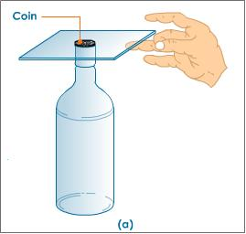
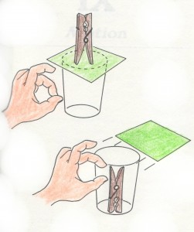
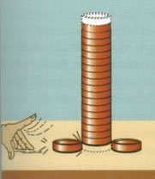
INERTIA Applied 2

Slide 9
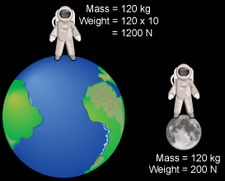
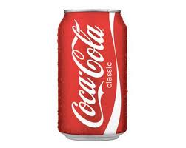
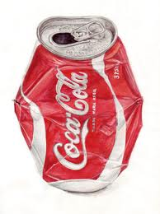
MASS is not…
VOLUME
WEIGHT
Mass = Material
Volume = Space
Mass = Material
Weight = Gravity
Empty Soda Can

Slide 10
NET FORCE on an object
Applied forces
Net forces
5 N
15 N
10 N
5 N
10 N
5 N
10 N
10 N
Net Force = ZERO means EQUILIBRIUM

Slide 11
INERTIA Applied 3

Slide 12
INERTIA Applied 4

