Slide 1
Newton’s 3rd Law (REACTION)
Physical Science - Physics

Slide 2
What is it?
For every action (force), there is an equal and opposite reaction (force)
If objects are different, then different outcomes can occur
A fly v.s. a truck
Can be tied back to the 1st and 2nd.

Slide 3
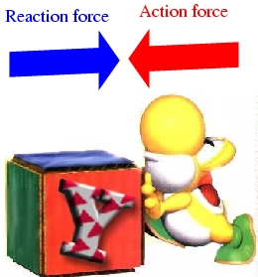
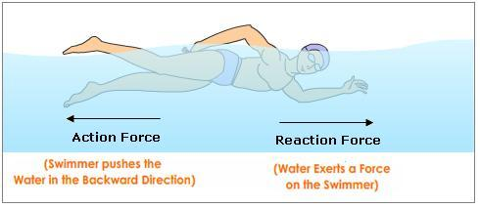
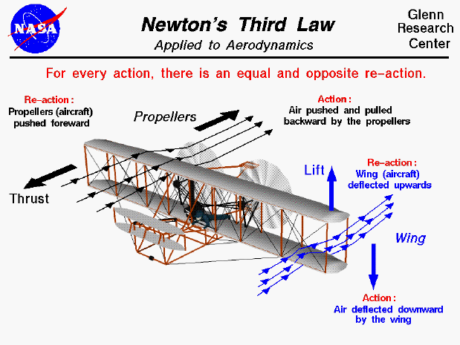
REACTION

Slide 4
REACTION

Slide 5
REACTION

Slide 6
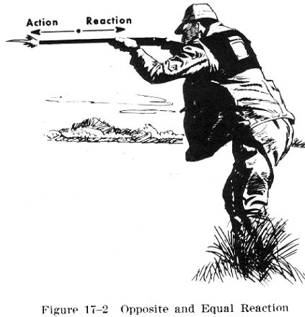
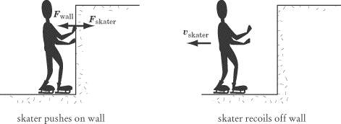
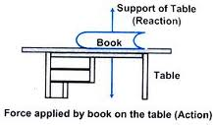
REACTION

Slide 7
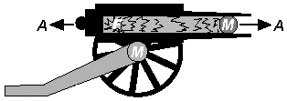
REACTION
Equal and Opposite Problem.
Acceleration of TWO DIFFERENT MASSES…Recoil…

