Slide 1
Chapter 2 – Free Fall
Conceptual Physics

Slide 2
Types of Linear Motion
Horizontal Linear Motion.
Vertical Linear Motion
Movement along the X-Axis
Examples.
Driving a car.
Flying a plane.
Skateboarding.
Etc.
Movement along the Y-Axis
Examples.
Sky Diving.
Bungee Jumping.
Cliff Diving.
Etc.

Slide 3
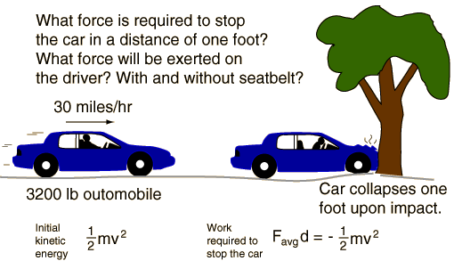
Types of Linear Motion
Horizontal Linear Motion.
Vertical Linear Motion

Slide 4
Vertical Linear Motion
Vertical Linear Motion = “Free Fall”.
Free Fall = Any object falling without being affected by AIR RESISTANCE.
Q: When falling, what pulls you to the ground?
A: GRAVITY!

Slide 5
Gravity.
A force that attracts ALL OBJECTS toward the Earth.
Free falling objects are affected ONLY BY gravity.
Gravity = g = 10 m/s²

Slide 6
Free Fall SPEED.
How fast an object is falling…
v = gt
v = speed (meters/second).
g = 10 m/s²
t = time (seconds).

Slide 7
Practice Practice Practice.
Q: What would the speedometer reading on a falling rock be 4.5 seconds after it drops from rest? 8 seconds? 15 seconds?
A: v = gt
v = (10 m/s²) (4.5 s) = 45 m/s
v = (10 m/s²) (8 s) = 80 m/s
v = (10 m/s²) (15 s) = 150 m/s

Slide 8
Free Fall DISTANCE
How far an object has fallen…
d = 5t²
d = Distance (meters)
t = Time (seconds)

Slide 9
Practice Practice Practice.
Q: How far will a rock fall off a cliff after 2 seconds of free fall? 4 seconds? 7 seconds?
A: d = 5t²
d = (5) (2²) = 20 m
d= (5) (4²) = 80 m
d = (5) (7²) = 245 m

Slide 10
Chapter 2 RECAP

