Slide 1
Newton’s Laws of Motion
Chapters 4-6

Slide 2
Previously on…
Motion: Anything that moves.
Chapter 2: Straight line motion.
Chapter 3: Projectile motion.
Chapters 4-6: Laws of Motion.

Slide 3
The men who paved the way.
Aristotle
Natural Motion:
Objects that move “on their own”.
Violent Motion:
Objects that are “forced to move”.
Galileo
Force:
Any push or pull on an object.
Friction:
Force between materials that touch.

Slide 4
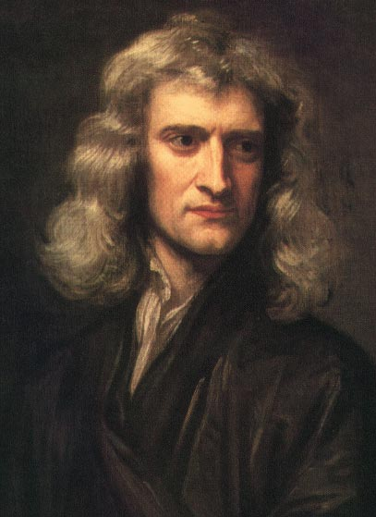
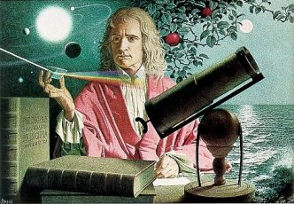
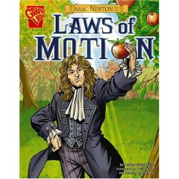
Sir Isaac Newton: Father of Physics

Slide 5
Newton’s 1st Law.
First Law of Motion…
Law of Inertia:
Every object continues in a state of rest, or of motion in a straight line at constant speed, unless it is changed by an outside force.
BASICALLY: You will keep moving or stay still until something makes you move or stop.

Slide 6
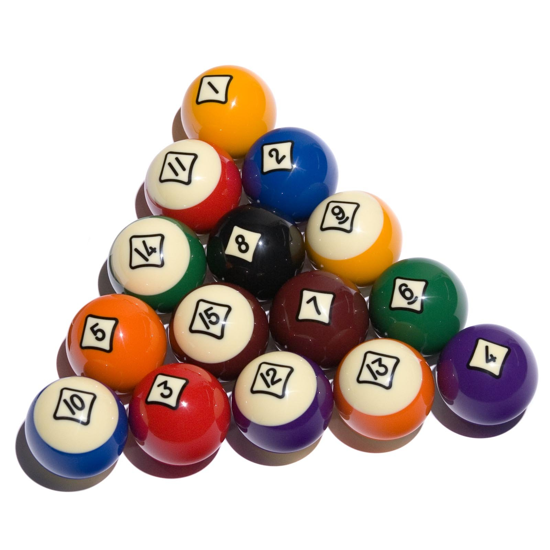
Newton’s 1st Law.
Think of pool…
The balls won’t move without the cue ball…
The balls won’t stop unless they hit something…

Slide 7
Newton’s 2nd Law.
Second Law of Motion…
Law of Acceleration.
The acceleration of an object depends on the force applied to that object and the object’s mass.
Force = mass X acceleration
F = ma

Slide 8
Force causes the Acceleration
If you apply more Force it will accelerate faster, with the same mass
If you have more mass, it will accelerate slower
If you double the mass, it will accelerate by halfIf you double the force, the acceleration doubles.
F=ma, prove it to yourself.
2=2a
4=2a
8=2a
2=2a
2=4a
2=8a
Look what happens to the acceleration!

Slide 9
Mass is not…
Volume
Weight
Mass = the amount of STUFF in an object.
Volume = the amount of SPACE in an object.
Bag of cotton v. Bag of Nails.
More mass?
More volume?
Mass = the amount of STUFF in an object.
Weight = the force of GRAVITY on an object.
g = 10 m/s²
1 kg = 10 N of force
(1 kg = 2.2 lbs.)

Slide 10
Applying the Force
Called Pressure
Pressure = Force over Area
P=F/A
The smaller the area, the more force felt
The greater the area, less force is felt

Slide 11
Freefall
Why don’t things fall at different rates?
A boulder has LOTS of mass = LOTS of inertia
A pebble has little mass = little inertia
Gravity accelerates everything equally
If boulder is 10x’s more massive it pulls 10x’s harder
f/m = F/m
v.s.

Slide 12
Newton’s 3rd Law.
Third Law of Motion…
Law of REACTION.
For every action, there is an equal and opposite reaction.
BASICALLY: Every force you exert, you have the same force back on you.

Slide 13
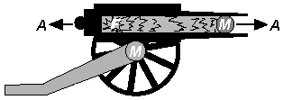
Forces…
ACTION FORCE.
REACTION FORCE.
Starting force.
Example:
Hammer hits a nail.
You push on the wall.
Tires push on the road.
Earth pulls the ball.
Reacting force.
Example:
Nail hits the hammer.
The wall pushes on you.
The road pushes the tires.
The ball pulls on the Earth.

