Slide 1
Circular Motion
Unit III Chapter 9

Slide 2
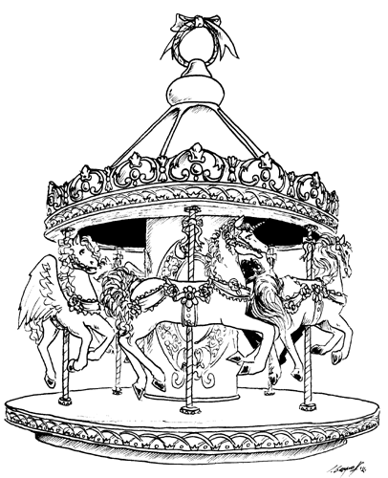
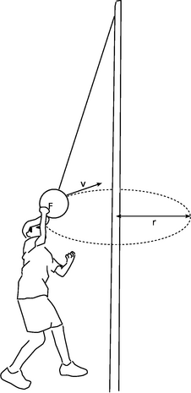
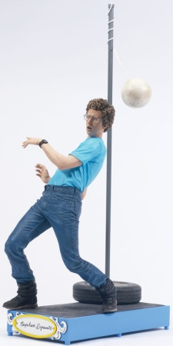
Rotation v. Revolution
AXIS: Straight line around circular motion takes place…
Rotation:
Moving around…
An INTERNAL axis.
Revolution:
Moving around…
An EXTERNAL axis.

Slide 3
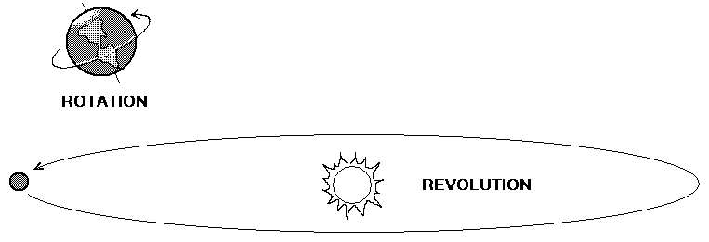
Rotation v. Revolution
AXIS: Straight line around circular motion takes place…

Slide 4
Rotation v. Revolution #1
The “Finnish Fling” is an interesting ride that puts passengers in a giant barrel-like cylinder and spins them SO FAST that the floor will drop and the riders will stick to the wall.
When referring to YOU and the RIDE…
Which one ROTATES while the other REVOLVES?

Slide 5
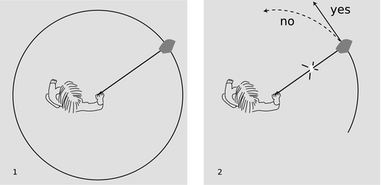
Rotational Speed
Speed: How fast an object moves…
Linear speed:
Tangential speed:
Rotational speed:
(Angular)
Distance over time.
Moving TANGENT to a circle.
# of rotations over time.
(RPMs)

Slide 6
Rotational Speed #1
Refer to the diagrams:
Imagine two lady bugs sitting
on a spinning turn table…
When referring to Lady bug 1 and 2…
Which has the fastest rotational speed?
Which has the fastest linear speed?
1
2

Slide 7
Rotational Forces
Centripetal Force
Centrifugal Force
Any force that causes an object to move in a circular path.
Latin: “Center Seeking”
Pulls you towards the center of the circular path.
Outward force of a rotating object.
Latin: “Center Fleeing”
Reaction to centripetal force.

Slide 8
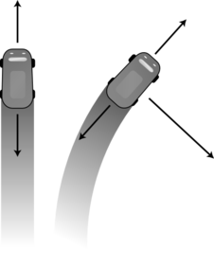
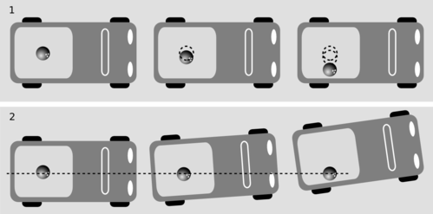
Rotational Forces

Slide 9
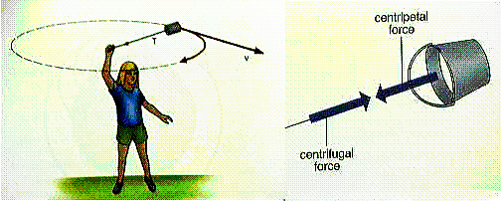
Rotational Forces

Slide 10
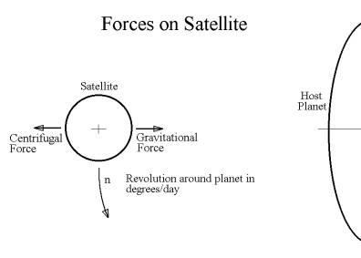
Rotational Forces

Slide 11
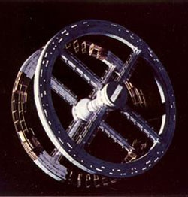
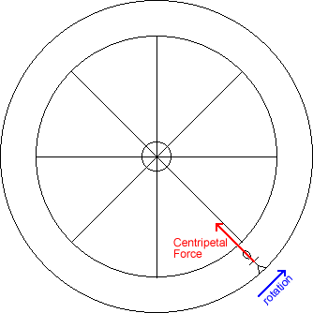
Simulated Gravity
Gravity created by…
CENTRIFUGAL FORCES

Slide 12
HOMEWORK
Page 133
#2, 5, 7, 9, 12, 13, 19, 20, 21, 22, 29, 33.

Slide 13
Comparison
Compare the following pairs…
Rotation | Revolution
Linear Speed | Rotational Speed
Centripetal Force | Centrifugal Force

Slide 14
Circular Motion Lab
Day 1 – Pre Lab.
Review the notes + book work.
Design the Cup Sling.
Prepare the materials.
Discuss the procedure.
Day 2 – Lab.
Conduct lab + obtain data.
Answer questions.

Slide 15
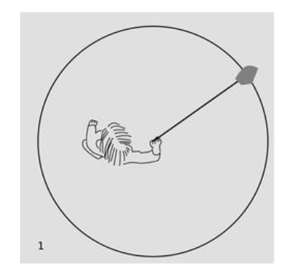
Rotational Forces

Slide 16
Circular Motion Lab
QUESTION: How are MASS, RPMs and FORCE related?
↑ Mass = ↑ Inertia = ↑ (centripetal) force.
↑ RPMs = ↑ Velocity = (ρ = mv)…so…
↑ RPMs = ↑ Velocity = ↑ Momentum = ↑ Force.
HYPOTHESIS: If you ↑ or ↓ mass, then you…
If you ↑ or ↓ RPMs, then you…
Result: Centripetal Force

